Slide 1
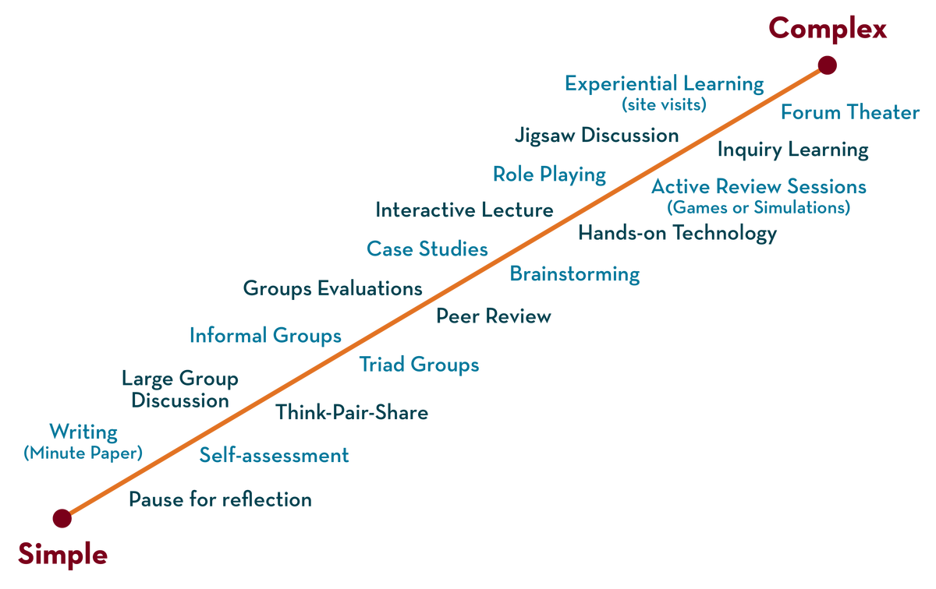
Department of BES-II
BASIC ELECTRICAL & ELCTRONIC CIRCUITS (BEC)
COURSE CODE : 23EC1203
Analog and Digital ICs
L-11

Slide 2



AIM OF THE SESSION
To familiarize students with the basic concept of analog and digital ICs
INSTRUCTIONAL OBJECTIVES
This Session is designed to:
Demonstrate the functionality of both analog and digital Integrated Circuits (ICs).
Describe examples of analog and digital Ics.
List out the applications of analog and digital Ics.
Describe workings and distinctions between analog and digital ICs.
LEARNING OUTCOMES
At the end of this session, you should be able to:
Define analog and digital Ics.
Describe working and examples for analog & digital Ics.
Summarize differences between analog and digital Ics.

Slide 3
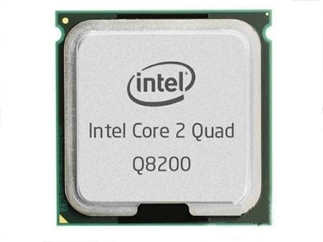
INTEGRATED CIRCUIT(IC)
An integrated Circuit is a semiconductor wafer on which thousands or millions of tiny resistors, capacitors and transistors are fabricated. If multiple electronic components are interconnected on a single chip of semiconductor material, then that chip is called as an Integrated Circuit (IC).
It consists of both active and passive components.
Integrated circuits offer many advantages.
Compact size
Lesser weight
Low power consumption
Reduced cost
Increased reliability
Improved operating speeds

Slide 4
Types of Integrated Circuits
Integrated circuits are of two types:
1.Analog Integrated Circuits (Analog ICs)
2. Digital Integrated Circuits (Digital ICs).
Analog Integrated Circuits Integrated circuits that operate over an entire range of continuous values of the signal amplitude are called as Analog Integrated Circuits. Examples of analog ICs include operational amplifiers (op-amps), voltage regulators, and audio amplifiers.
Digital Integrated Circuits are electronic circuits that process discrete signals or information represented as a sequence of numbers. They operate with distinct states, typically represented as 0s and 1s (binary).
Examples of digital ICs include microprocessors, memory chips (like RAM and ROM), and logic gates (such as AND, OR, and NOT gates).

Slide 5
Analog IC vs Digital IC comparison
Functions and application: From the definition, analog ICs are used in applications where the signals are continuous and and can change instantaneously. On the other hand, digital ICs are used in applications that have well-defined signals-high and low.
Size: In terms of size, analog chips tend to be relatively bigger and bulkier than the digital ICs. This could be due to the fact that they have more components.
Design: Analog chips tend to feature more complex designs than the digital ICs. Most digital chips are simple and can be easily integrated into circuits.
Noise levels: Analog chips tend to be more susceptible to the electrical noise than the digital chips. This is mainly due to the nature signals that they work on. Analog ICs are designed to work on continuous signals which have more noise levels than for signals with defined state(High or Low).
Price: Neither analog nor digital IC is more expensive or cheaper than the other.

Slide 6
Characteristics of Analog ICs
Analog Integrated Circuits (ICs) possess specific characteristics that make them suitable for various applications involving continuous signals. Here are some key characteristics of analog ICs along with examples
1. Continuous Signal Processing: Analog ICs are designed to handle continuous signals.
2. Signal Accuracy and Precision: Analog ICs focus on preserving the accuracy and fidelity.
3. Variable Voltage Levels: Analog circuits operate with varying voltage or current levels and are sensitive to changes.
4.Complexity and Precision in Design: Analog circuits can be intricate, requiring careful design to ensure minimal distortion and noise.
5.Low Power Consumption: Analog ICs typically consume less power compared to their digital counterparts

Slide 7
Characteristics of Digital ICs
Digital Integrated Circuits (ICs) have distinct characteristics that differentiate them from analog ICs. Here are key characteristics of digital ICs along with examples.
Binary Signal Processing: Digital ICs process discrete signals represented in binary form.
Boolean Logic Operations: Perform various logical operations following Boolean algebra.
Robustness to Noise:Digital circuits work with distinct voltage levels (high and low) representing binary states, making them more tolerant to noise compared to analog.
Design Scalability: Field-Programmable Gate Arrays (FPGAs) are digital ICs used for prototyping, testing, and implementing digital circuits and systems.
Power Consumption:consume more power compared to analog circuits
Data Storage and Processing: Random Access Memory (RAM) chips are digital Ics used to store data in binary form and allow quick access for processing.

Slide 8
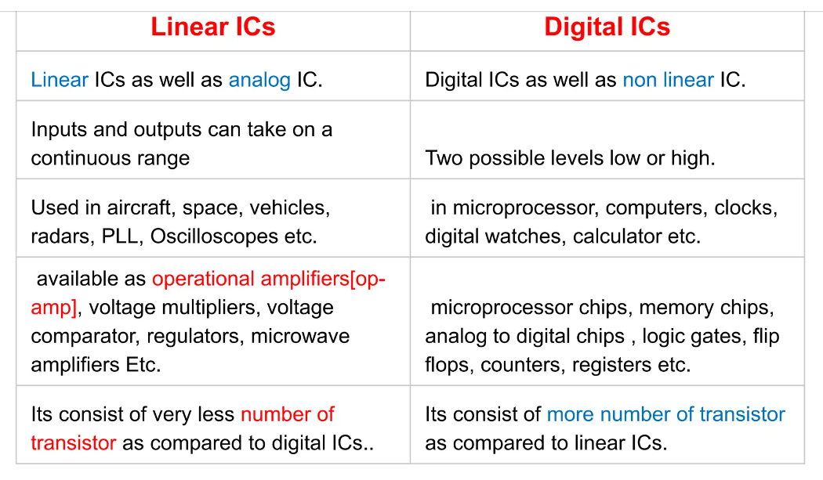
Differences between analog(Linear) & Digital ICS

Slide 9
Analog Ics and digital Ics examples:
Analog Integrated Circuits (ICs): Operational Amplifiers (Op-Amps),LM741, LM324, LM358,Voltage Regulators: LM78XX series (Positive voltage regulators),LM79XX series (Negative voltage regulators)
Digital Integrated Circuits (ICs): Logic Gates:74LSXX series (Low-power Schottky TTL),74HCXX series (High-speed CMOS), Flip-Flops and Latches:74LS74 (D-type flip-flop)74HC373 (Octal D-type transparent latch)

Slide 10

ACTIVITIES/ CASE STUDIES/ IMPORTANT FACTS RELATED TO THE SESSION

Slide 11
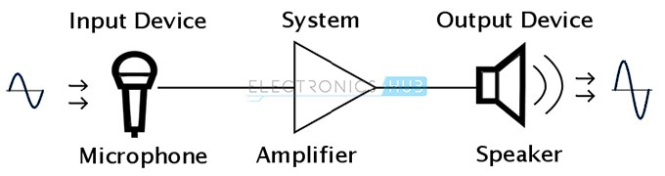
EXAMPLES
Analog ICs are used as Amplifiers in this example. Analog ICs manipulate signals representing physical quantities like sound, light, temperature, or pressure. They facilitate tasks such as amplification, filtering, modulation, and signal processing in numerous electronic devices.
Digital ICs perform operations based on binary logic, enabling precise handling and manipulation of digital data. Digital ICs include microprocessors, microcontrollers, memory chips (like RAM and ROM), logic gates (AND, OR, NOT, etc.), and specialized digital signal processing (DSP) chips.

Slide 12
SUMMARY
Analog Integrated Circuits (ICs) are electronic circuits that process continuous signals. They handle information that varies smoothly and can take on any value within a range. Examples of analog ICs include operational amplifiers (op-amps), voltage regulators, and audio amplifiers.
Digital Integrated Circuits (ICs) are electronic circuits that process discrete signals or information represented as a sequence of numbers. They operate with distinct states, typically represented as 0s and 1s (binary). Examples of digital ICs include microprocessors, memory chips (like RAM and ROM), and logic gates (such as AND, OR, and NOT gates).

Slide 13
SELF-ASSESSMENT QUESTIONS
1.The Input or Output voltages are limited upto two levels (Low or High) of ___________ ICs.
a. Analog
b. Digital
c. Linear
d. Non-Linear
Answer: b
The inputs of Linear or Analog Integrated Circuits (LIC) is ___________ to the Outputs.
a. Directly Proportional
b. Indirectly Proportional
Answer: a

Slide 14
TERMINAL QUESTIONS
1. Describe functionality of Analog Ics and Digital Ics.
2. List out differences between analog and digital Ics.
3. Discuss advantages and Disadvantages of Analog ICS.
4. Discuss advantages and Disadvantages of Digital ICS.

Slide 15
REFERENCES FOR FURTHER LEARNING OF THE SESSION
Reference Books:
1. Ramakanth A. Gayakwad, Op-Amps & Linear ICs , 4 th Edition , Pearson, 2017.
2. Sergio Franco, Design with operational amplifiers and analog integrated circuits, Mc Graw Hill Education, 3rd Edition, 2017
Sites and Web links:
1. https://www.tutorialspoint.com/digital-integratedcircuits.
2. https://ekeeda.com/library/electrical-engineering

Slide 16
THANK YOU
Team – BASIC ELECTRICAL & ELCTRONIC CIRCUITS (BEC)

